Slide 1
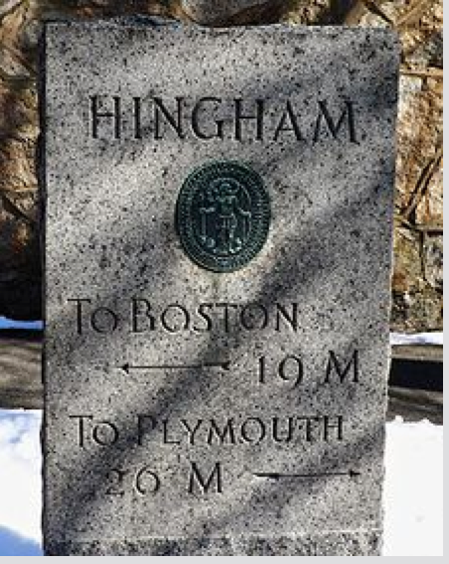
Advancing an Age Friendly Hingham
Caitlin Coyle, PhD
Beth Rouleau, MA
Mary Krebs, MS
Center for Social & Demographic Research on Aging
Gerontology Institute
UMass Boston
Notes:
Introductions and what is next:

Slide 2
Our Collaborative Efforts in the Region
Blue Hill Regional Coordinating Council is leading the effort, in partnership with MAPC, Umass Boston, WalkBoston and municipal partners. Their work is supported by Tufts Health Plan Foundation, Beth Israel-Hingham and South Shore Hospital.

Slide 3
An Age Friendly Community
Age Friendly State
Needs Assessment 2013
Master Plan update underway
Active Senior Center
Tax Work-Off Program
Exploring the Age Friendly Network
Transportation
Housing
Social participation
Outdoor space and buildings
Age Friendly Hingham
Community support and health services
Respect and social inclusion
Communication and information
Civic participation and employment
Notes:
A livable community draws on the WHO’s “age friendly” community model. This model provides a framework for making a community more livable for older residents specifically. It operates under an assumption that a community that is good for older people is a community that is good for ALL people. Intended to benefit residents of all ages and abilities—including persons with dementia and their care partners. Things like safe intersections and opportunities for social participation that accommodate a wide number of interests and abilities simply allow residents to stay in the communities they love and thrive in doing so.
An initiative like Livable Hingham provides an opportunity to thoughtfully reshape the ways communities are designed and how they go about supporting the goals of residents.

Slide 4
Hingham’s 60+ population and projections to 2030

Slide 5
What we heard…

Slide 6
Community Conversations
We facilitated community conversations in each of the 7 communities in the “metro Quincy area”
Randolph
Weymouth
Quincy
Braintree
Milton
Hull
Hingham
We facilitated 1 community conversations in Hingham
~ 17 attendees in total

Slide 7
Barriers to Accessibility in Hingham
Transportation | Limited capacity of volunteer drivers, parking at train stations Need is higher than offerings Limited schedules
Public Spaces | Car-dependent community Limited public transportation to access outdoor spaces Limited parking fills up quickly Complete streets initiative has not been started, cross-walks and sidewalks need attention
Social Participation | Limited opportunities for multi-generational activities Access to Hingham’s outdoor spaces is difficult for older adults and people with mobility needs
Communication | Inconsistent information about Town messages

Slide 8
Suggested Action Steps to Address Needs:
Build volunteer base
For rides, errands, etc.
Look at Fish, the Barnstable model, or other town transportation programs.
Promote intergenerational meet-ups in Hingham
Hold regional discussions about improving transportation options
Investigate trusted rideshare options
Look into ways for the fire department to coordinate with health services to improve access to medical transportation for vulnerable residents
Look into ways to increase amount of parking for older adult
For example, designated parking spaces for older adults
Look into ways to expand the hours and volunteer capacity of older adult transportation
Host quarterly stakeholder coffee hours to share information

Slide 9
Possible Next Steps Towards Age-Friendliness:
Establish an age friendly steering committee
Engage residents in the process
Conduct a review of recent planning processes in Hingham to identify existing “age friendly efforts” and incorporate age friendly language where appropriate
Develop a set of priority areas for the Town to move towards its age friendly goals
Involve the steering committee in taking action within those priority areas

Slide 10
Thank you!
Caitlin Coyle, PhD
Gerontology at UMass Boston
caitlin.coyle@umb.edu

